Slide 1



Profanity Filter
MINI-PROJECT PRESENTATION
on
By
DEVANSH SRIVASTAVA 1900300130031
UNDER THE SUPERVISION OF
Dr. Tanvi Gautam
INDERPRASTHA ENGINEERING COLLEGE , GHAZIABAD, UTTAR PRADESH
AFFILIATED TO DR. A.P.J. ABDUL KALAM TECHNICAL UNIVERSITY .LUCKNOW, UTTAR PRADESH
(SESSION: 2020 - 2021)

Slide 2
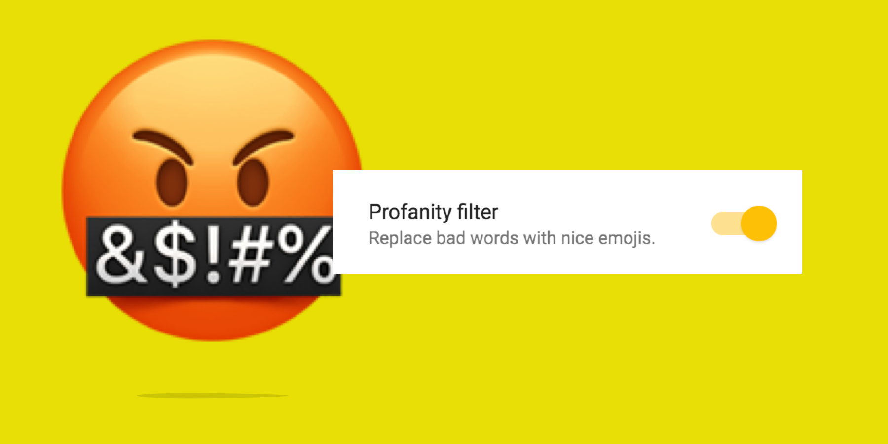

Slide 3
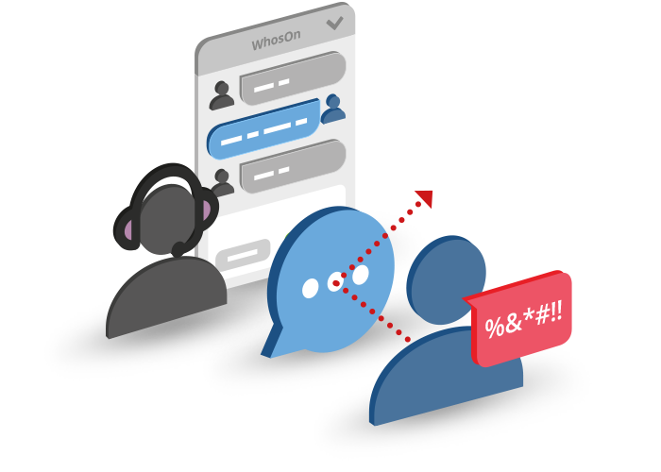
Index
Introduction
Objective
Roles
Hardware And Software Used
Scope
Methodology
Use Case Of Chat-bot
Project Glimpse
Flow-chart Of Coding
Security
Limitations
Future-scope
References

Slide 4
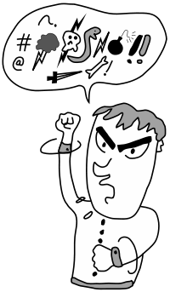
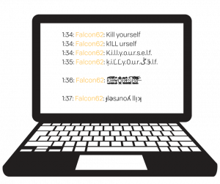

Introduction
People now-a-days have many negative thoughts and ideas and they post inappropriate words in public through comment section.
Profanity filter acts as a wall to block such words and content.

Slide 5
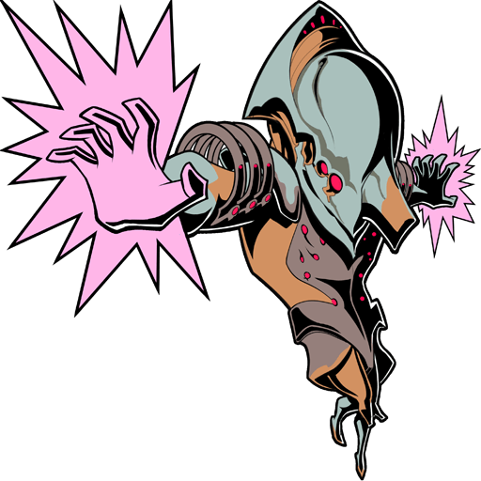

How is it any different from other Profanity filters available in the market
It primary focus is on INDIAN audience, Hinglish language (that is English + Hindi) also called as Indian slang

Slide 6


objective
Remove the Cuss sentences and words so that people are not able to spread hate among the people.

Slide 7




requirements
Software:-
HTML 5
CSS 3
Bootstrap 4.5.0
Flask for front-end
Machine Learning Model for back-end
MYSQL - 5.2.5 for database
Git 5.2.5 for version control.
Browser
Chrome, firefox, opera, safari.
Hardware
Minimum RAM 2 Gb,
Intel core i5 processor
Operating System
Windows (7, 8, 10), Linux, Mac(OS X)

Slide 8


Scope
Website has a clean and systematic user interface .
User can personalize, check the comment on their feeds which will be send to the model in JSON format .
Security parameters included for a safe connection of database with our application.
Includes live responses .

Slide 9
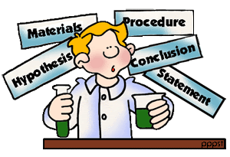

MEthodology
Implementation of Naïve byes machine learning algorithm.
Naïve byes was the best model since the memory consumption and the time of execution was comparatively less than other deep learning, machine learning models like KNN(K-nearest neighbors), Linear regression, random forest
MEMORY CONSUMPTION BY MODEL:
Memory consumed by FIT-139 Mb
PREDICT-139 Mb

Slide 10


Convert the comment (that is in text format) into numerical format using NLP (natural language processes),
For cleaning of text, included the stop words and used Porter stemmer to easily compute the similarity between 2 documents using it.

Slide 11
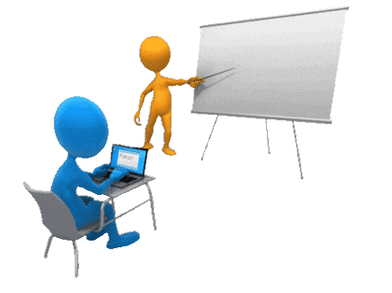


3. Train the model and predict the result
For the independent variable we converted into numbers using get_dummmies
After our model is created we will do the deployment using flask.

Slide 12

Why chose this technique
We chose Naïve Byes machine learning model rather than using deep learning models, Vader library, because,
Deep learning techniques, most of the applied features need to be identified by an domain expert in order to reduce the complexity of the data and make patterns more visible to learning algorithms to work.
VADER we have to edit the inbuilt python library by new Hinglish words and that would require a lot of time and resources.

Slide 13
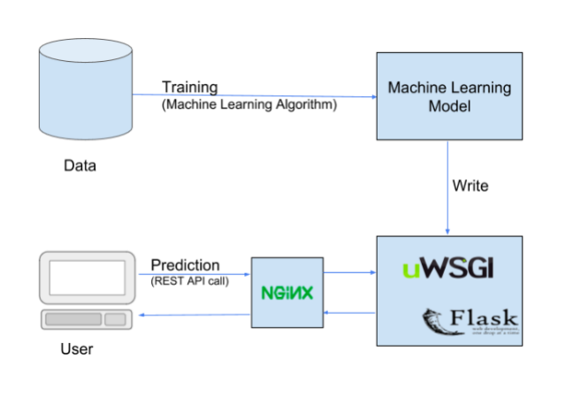

Slide 14
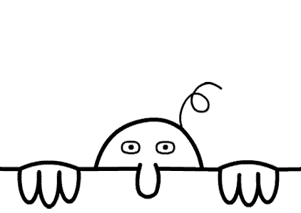
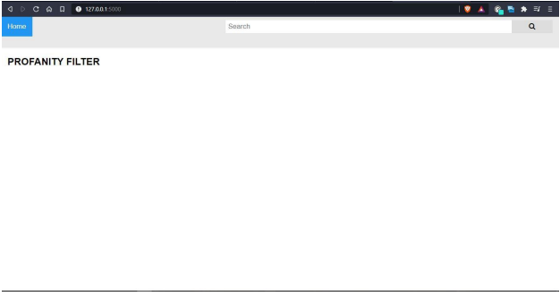
Project Glimpse

Slide 15
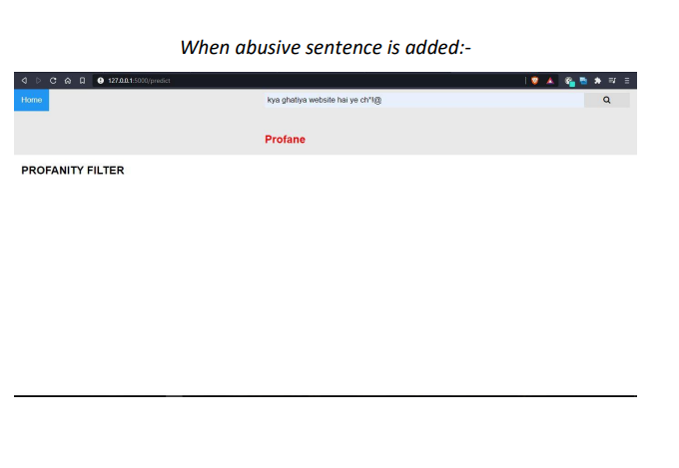

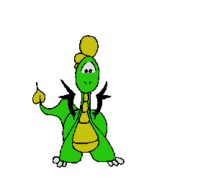


Slide 16
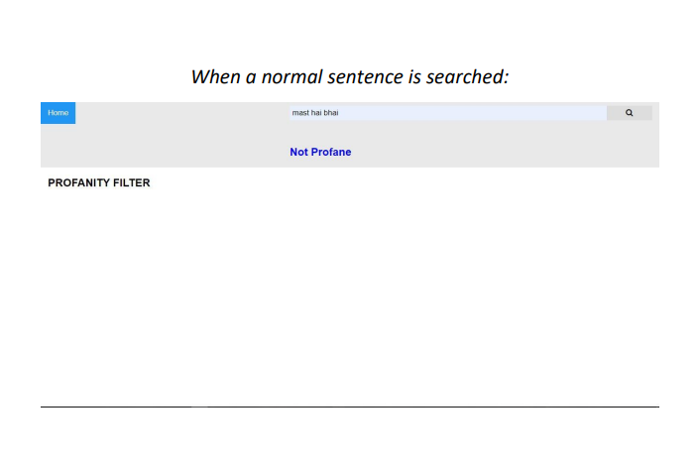



Slide 17
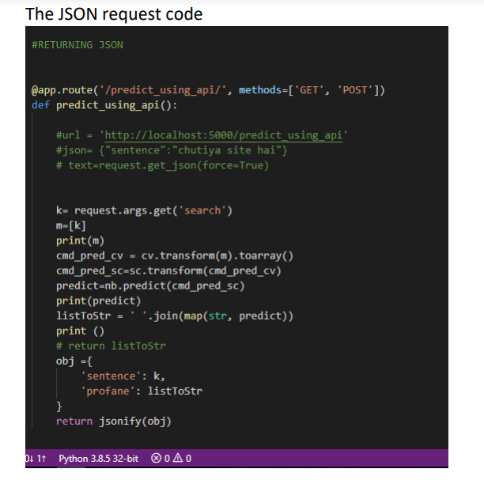

Slide 18
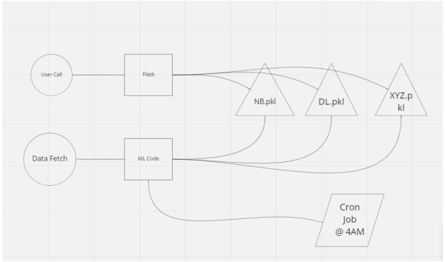
FLOw chart

Slide 19
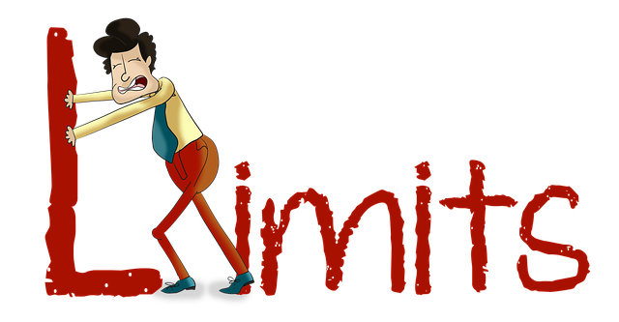
LIMITATIONS:-
Problems faced while holding multiple sessions for users.
OverBiasing of the model
Couldn’t Add/Train Large Amount Of Data in chatbot
Don’t Have An Advanced Authentication Algorithm .

Slide 20

FUTURESCOPE:-
Make an API and try to implement it on various social networking platform
If found Profane then will take necessary actions
Transparent Data Encryption (TDE) will be added to have encrypted data transmission and encryption at rest.
Set Scheduler @4AM everyday

Slide 21
REFERENCES:-
For flask – “Tutorial’s point ”
For Front - End - Css - Tricks And Wix.Com To Get The Basic Skeleton For The Project.
For Back-end - Documentation Of MYSQL .
For Backend model – “Different types of Ml models” Medium.com

Slide 22


